Slide 1
Yocto

Slide 2
Yocto
Introduction
Getting Started
Recipes
Layers
QA

Slide 3
Introduction

Slide 4
What is the Yocto Project?
Homepage https://www.yoctoproject.org/
“The Yocto Project is an open source collaboration project that provides templates, tools and methods to help you create custom Linux-based systems for embedded and IOT products, regardless of the hardware architecture.”
Supports ARM, PPC, MIPS, x86 (32 & 64 bit)
Open source project with a strong community
Consists of set of tools which includes task execution engine - BitBake and OpenEmbedded-Core (OE-Core) - a common layer of metadata (i.e. recipes, classes, and associated files).

Slide 5
What is the Yocto Project?
Content
Complete Linux OS with package metadata
Releases every 6 months with latest (but stable) kernel, toolchain, and package versions, Cutting-edge metadata tracking a variety of open source upstreams
Common Linux BSP format and reference images, place for Industry to publish BSPs
App Dev Tools which allow development against the stack, including Eclipse plug-ins and emulators
Full documentation representative of a consistent system It’s not an embedded Linux distribution – It creates a custom one for you.

Slide 6
Yocto Project Build System
Metadata: Recipe files, configuration & append files and patches
Machine/ BSP Configuration: Specific to the target hardware for which the image/ SDK is being built.
Distro Layer/Policy Configuration: Policies specific to a particular distribution. Consist of class files, configuration files, and various recipes for custom image.
OpenEmbedded Build System.
BitBake.
Poky Build System.

Slide 7
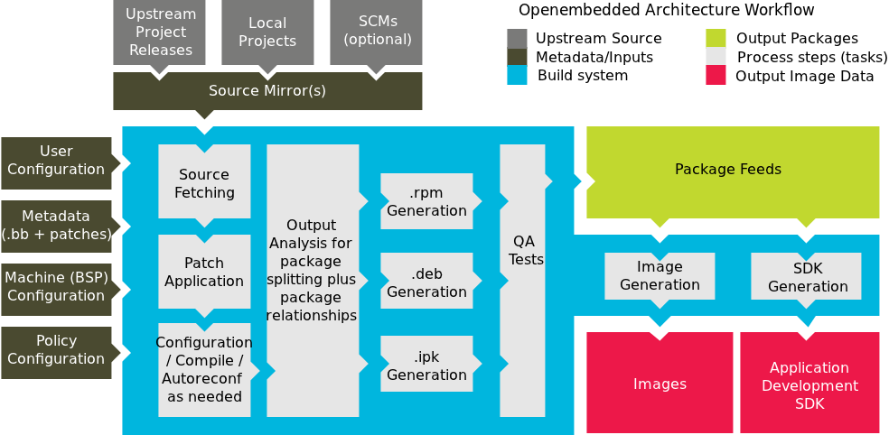
Yocto Project Workflow

Slide 8
Getting Started

Slide 9
Get Yocto sources
https://github.com/Freescale/fsl-community-bsp-platform/
Install the repo utility
$: mkdir ~/bin
$: curl http://commondatastorage.googleapis.com/git-repo-downloads/repo > ~/bin/repo
$: chmod a+x ~/bin/repo
Download the BSP source
$: PATH=${PATH}:~/bin
$: mkdir fsl-community-bsp
$: cd fsl-community-bsp
$: repo init -u https://github.com/Freescale/fsl-community-bsp-platform
$: repo sync

Slide 10
Get Yocto sources
https://github.com/Freescale/fsl-community-bsp-platform/
Install the repo utility
$: mkdir ~/bin
$: curl http://commondatastorage.googleapis.com/git-repo-downloads/repo > ~/bin/repo
$: chmod a+x ~/bin/repo
Download the BSP source
$: PATH=${PATH}:~/bin
$: mkdir fsl-community-bsp
$: cd fsl-community-bsp
$: repo init -u https://github.com/Freescale/fsl-community-bsp-platform
$: repo sync

Slide 11
Get Yocto sources
fsl-community-bsp/.repo/manifests/default.xml
<remote fetch="https://git.yoctoproject.org/git" name="yocto"/>
<remote fetch="https://github.com/Freescale" name="freescale"/>
<remote fetch="https://github.com/openembedded" name="oe"/>
<project remote="yocto" revision="thud" name="poky" path="sources/poky"/>
<project remote="yocto" revision="thud" name="meta-freescale" path="sources/meta-freescale"/>
<project remote="oe" revision="thud" name="meta-openembedded" path="sources/meta-openembedded"/>
<project remote="freescale" revision="thud" name="fsl-community-bsp-base" path="sources/base">
<linkfile dest="README" src="README"/>
<linkfile dest="setup-environment" src="setup-environment"/>
</project>
<project remote="freescale" revision="thud" name="meta-freescale-3rdparty" path="sources/meta-freescale-3rdparty"/>
<project remote="freescale" revision="thud" name="meta-freescale-distro" path="sources/meta-freescale-distro"/>
<project remote="freescale" revision="thud" name="Documentation" path="sources/Documentation"/>
Source URLs
Revisions

Slide 12
Get Yocto sources
fsl-community-bsp/
├── README -> sources/base/README
├── setup-environment -> sources/base/setup-environment
└── sources
├── base
├── Documentation
├── meta-freescale
├── meta-freescale-3rdparty
├── meta-freescale-distro
├── meta-openembedded
└── poky

Slide 13
Yocto build configuration
Configure your build
$: source ./setup-environment build
Edit conf/local.conf user config
MACHINE ?= "twr-vf65gs10“
BB_NUMBER_THREADS = "4“
PARALLEL_MAKE = "-j 4“
DL_DIR ?= “<path>/downloads/”
SSTATE_DIR ?= “<path>/sstate”
Start build
$: bitbake core-image-minimal
Source: ./sources/poky/meta/recipes-core/images/core-image-minimal.bb

Slide 14
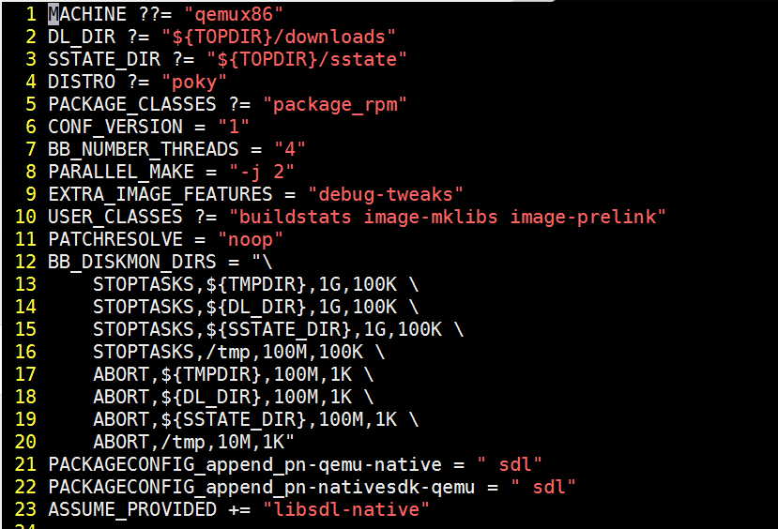
Yocto build configuration
conf/local.conf

Slide 15
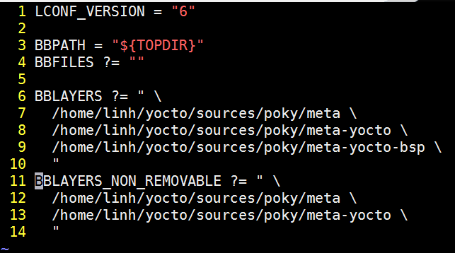
Yocto build configuration
conf/bblayers.conf

Slide 16
Common targets
core-image-minimal: A small image to boot a device and have access to core command line commands and services.
core-image-sato: Image with Sato support. Sato is a GNOME mobile-based user interface.
meta-toolchain: Includes development headers and libraries to develop directly on the target.
meta-ide-support: Generates the cross-toolchain. Useful when working with the SDK.
adt-installer: Build the application development toolkit installer.
Usually defined in */receipes-*/images/
./poky/meta/recipes-sato/images/
./meta-fsl-arm/recipes-graphics/images

Slide 17
Bitbake
bitbake [options] [recipe/target ...] Selected Useful Options
--version show program's version number and exit -h, --help show this help message and exit -k, --continue continue as much as possible after an error. -f, --force force run of specified cmd, regardless of stamp status -c CMD, --cmd=CMD specify task to execute. -v, --verbose output more chit-chat to the terminal -D, --debug increase the debug level. -n, --dry-run don't execute, just go through the motions -s, --show-versions show current and preferred versions of all packages -e, --environment show the global or per-package environment -g, --graphviz emit the dependency trees of the specified packages -u UI, --ui=UI user interface to use

Slide 18
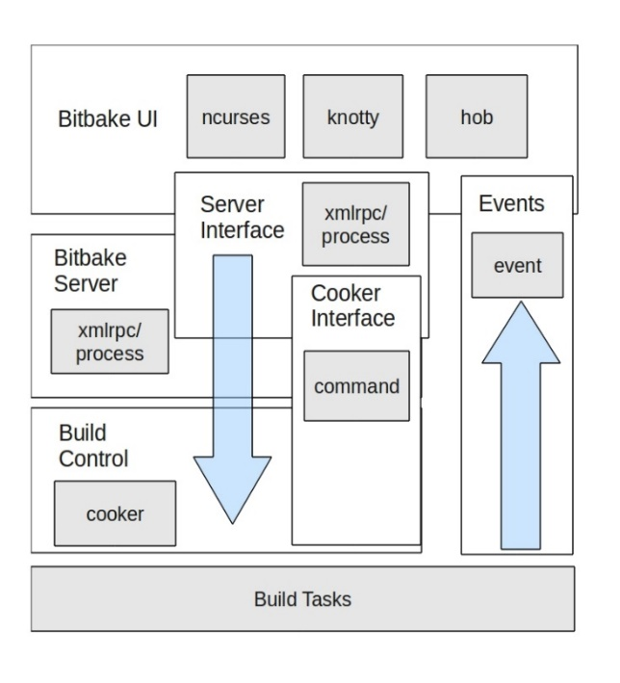
BitBake
BitBake must always be executed from within the <build_env> directory
When bitbake (a Python script) runs :
it parses recipes and tasks
determines task queue dependencies
prepares and executes a run queue of tasks, which perform the steps needed to obtain the desired result, e.g. image generation
www.aosabook.org/images/yocto/aosa3.jpg

Slide 19
Bitbake
bitbake [options] [recipename/target …]
bitbake foo: build target foo
bitbake –b foo-0.1.bb: build recipe foo-0.1.bb
bitbake –c clean foo: clean target foo
bitbake –c fetchall foo: download all requirements for target foo
bitbake –b foo-0.1.bb –c fetch: Download requirement for recipe foo-0.1.bb

Slide 20
Bitbake
bitbake <image> -g -u depexp: show package dependency for image
bitbake <package> -c devshell: Open a new shell where with neccesary system values already defined for package
bitbake <package> -c listtasks: list all tasks for the package
bitbake virtual/kernel -c menuconfig: Interactive kernel configuration

Slide 21
Useful BitBake Tasks to Run Manually
clean : remove the work folder of the package
cleansstate : clean + delete the cached binary When a known good package fails to build unexpectedly or an image build fails with "error: Failed dependencies", do -c cleansstate first on the failing package, then rebuild
patch : install source including all patches
menuconfig :run kernel menuconfig
Not for regular use, so extreme caution is advised :
cleanall : delete the source archive from ../sources

Slide 22
Tasks order
do_fetch: Fetches the source code by ${SRC_URI}
do_unpack: Unpacks the source code into a working directory pointed to by ${WORKDIR}
do_prepare_recipe_sysroot: Installs the files into the individual recipe specific sysroots
do_patch: Locates patch files and applies them to the source code
do_configure: Configures the source by enabling and disabling any build-time and configuration options for the software being built

Slide 23
Tasks order
do_compile: Compiles the source code. This task runs with the current working directory set to ${B}.
do_install: Copies files that are to be packaged into the holding area ${D}
do_package: Analyzes the content of the holding area ${D} and splits the content into subsets based on available packages and files
do_deploy: Writes output files that are to be deployed to ${DEPLOY_DIR_IMAGE}. The task runs with the current working directory set to ${B}.
do_image: Starts the image generation process

Slide 24
Yocto result
tmp/buildstats/ Build statistics for all packages built (CPU usage, elapsed time, host, timestamps...).
tmp/deploy/ Final output of the build.
tmp/deploy/images/ Contains the complete built images. These images are used to flash the target.
tmp/sysroots/ Shared libraries and headers used to compile packages for the target but also for the host.
tmp/work/ Set of specific work directories, split by architecture. They are used to unpack, configure and build the packages. Contains the patched sources, generated objects and logs.

Slide 25
Yocto result
The build environment ${TMPDIR} folder receives all build output :
<build_env>/tmp
├── buildstats ├── cache
├── deploy
│ ├── images
│ ├── licenses
│ ├── rpm │ └── sdk
├── log
├── sstate-control
├── stamps ├── sysroots
│ ├── x86_64-linux
├── work
└── work-shared
Generated image files (kernel, u-boot, rcw, rfs, ...)
Installable .rpm files of built packages
Shared header files and libraries

Slide 26
Source Modifications In The Working Directory Implications
Assume a package’s source files have been installed in its working directory and the user has manually modified source files
If a BitBake image depends on this package, it will not be able to determine these manual changes :
A package rebuild will not be rebuild triggered by an image.
Manually forced a clean of the package, before an BitBake image build command : “ You changed it ? You clean it ! "
Recommendation :
It is preferred to work on a private copy of the source tree and build it in a devshell, so as to keep manual work and BitBake build state separate
$ bitbake –c clean –f <pkg>

Slide 27
Useful BitBake Options
Enable build output : -v
Generate bitbake debug output : -D, -DD, -DDD
Force rerun of specified task : -f, --force
Dump the environment : -e, --environment
Dump package dependency list : -g, --graphviz
Continue even in case of error : -k, --continue

Slide 28
BitBake Execution Logs
For each executed BitBake task, the generated script and the log file are written to the package's temp folder, e.g. :
Whenever a BitBake task for a package completes, the path to the log file capturing successful completion or failure is displayed : check the content to debug any build issues.
To log output to console (e.g. from make) during the build, add the -v, --verbose option
$ cd <build_env>/tmp/work/s32v234evb-fsl-linux/u-boot-s32v2xx/2016.01-r0/temp/ $ ls -la | grep deploy
lrwxrwxrwx 1 public public 28 Th09 29 16:49 log.do_deploy_setscene -> log.do_deploy_setscene.18218
-rw-rw-r-- 1 public public 746 Th09 29 16:49 log.do_deploy_setscene.18218
lrwxrwxrwx 1 public public 28 Th09 29 16:49 run.do_deploy_setscene -> run.do_deploy_setscene.18218
-rw-rw-r-- 1 public public 13604 Th09 29 16:49 run.do_deploy_setscene.18218

Slide 29
Bitbake Build Output
$ bitbake fsl-image-s32v2xx
Loading cache: 100% |##################################| ETA: 00:00:00
Loaded 2458 entries from dependency cache.
NOTE: Resolving any missing task queue dependencies
Build Configuration:
BB_VERSION = "1.26.0"
BUILD_SYS = "x86_64-linux"
NATIVELSBSTRING = "Ubuntu-14.04"
TARGET_SYS = "aarch64-fsl-linux"
MACHINE = "s32v234evb"
DISTRO = "fsl-networking"
DISTRO_VERSION = "1.8"
TUNE_FEATURES = "aarch64"
TARGET_FPU = ""
meta
meta-yocto
meta-yocto-bsp
meta-fsl-arm
meta-fsl-networking
meta-fsl-toolchain
meta-virtualization = "<unknown>:<unknown>"
meta-fsl-s32v = "develop:d0eb78973515afa7aa583c906d64d38d6a55f111"
meta-oe
meta-networking
meta-python
meta-webserver
meta-filesystems
meta-linaro
meta-aarch64
meta-linaro-toolchain = "<unknown>:<unknown>"
NOTE: Preparing RunQueue
NOTE: Executing SetScene Tasks
NOTE: Executing RunQueue Tasks

Slide 30
RECIPEs

Slide 31
Linux recipe
meta-freescale/recipes-kernel/linux/linux-imx_4.14.98.bb
# Copyright 2013-2016 (C) Freescale Semiconductor
# Copyright 2017-2019 (C) NXP
# Copyright 2018 (C) O.S. Systems Software LTDA.
# Released under the MIT license (see COPYING.MIT for the terms)
SUMMARY = "Linux Kernel provided and supported by NXP"
DESCRIPTION = "Linux Kernel provided and supported by NXP with focus on \
i.MX Family Reference Boards. It includes support for many IPs such as GPU, VPU and IPU."
require recipes-kernel/linux/linux-imx.inc
DEPENDS += "lzop-native bc-native"
SRCBRANCH = "imx_4.14.98_2.0.0_ga"
LOCALVERSION = "-imx"
SRCREV = "1175b59611537b0b451e0d1071b1666873a8ec32"
SRC_URI += "file://0001-compiler-attributes-add-support-for-copy-gcc-9.patch \
file://0002-include-linux-module.h-copy-init-exit-attrs-to-.patch \
"
DEFAULT_PREFERENCE = "1"
COMPATIBLE_MACHINE = "(mx6|mx7|mx8)"

Slide 32
Recipe Requirements
A recipe should define :
DESCRIPTION : package description ^{(*)}
LICENSE : list of package source licenses. For closed source packages, use LICENSE="CLOSED"
LIC_FILES_CHKSUM : checksums of the license text in the recipe source code
SECTION : section where package should be put ^{(*)}
HOMEPAGE : website with info about package
AUTHOR : email address used to contact the original author or authors in order to send patches, forward bugs, etc.
SRC_URI : list of source files - local or remote

Slide 33
Common variables
Variable Name | Meaning
BUILDDIR | Location of the Build Directory
B
D | Location of destination directory = ${WORKDIR}/image
DL_DIR | Location of directory used by the build process to store downloads = ${TOPDIR}/sources
IMAGE_ROOTFS | Location of the root file system while it is under construction
S | Location in the Build Directory where unpacked recipe source code resides
STAGING_DIR | Location of the top-level sysroots directory = ${TMPDIR}/sysroots
TMPDIR | Base directory or all build output and intermediate files (other than the shared state cache) = ${BUILDDIR}/tmp.
TOPDIR | Top-level Build Directory
WORKDIR | Recipe specific work directory in which the build system builds a recipe = ${TMPDIR}/work/${MULTIMACH_TARGET_SYS}/${PN}/${EXTENDPE}${PV}-${PR}
PN | A recipe name or a resulting package name.
PR | The revision of a recipe
PV | The version of the recipe

Slide 34
Common operators
Operator | Operation | Example | Resulting Value
= | Set to a value | VAR1 = "value" | "value"
${VAR} | Expand | VAR2 = "X${VAR1}Y" | "XvalueY"
?= ??= | Set to a default value | VAR1 ?= "defval" VAR1 ??= "defval" | if VAR1 unassigned : "defval" else VAR1 unchanged
:= | Immediate expansion | VAR1 = "value" VAR1 := "${VAR1}append | "value" "valueappend"
+= | Append | VAR1 = "value" VAR1 += "Y" | "value" "value Y"
=+ | Prepend | VAR1 = "value" VAR1 =+ "X" | "value" "X value"
.= | Append (no space) | VAR1 = "value" VAR1 .= "Y" | "value" "valueY"
=. | Prepend | VAR1 = "value" VAR1 =. "X" | "value" "Xvalue"

Slide 35
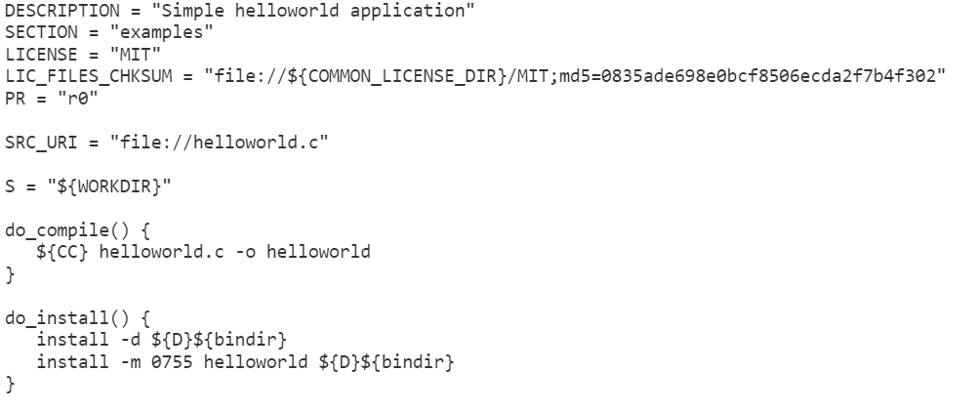
Write recipe for new package
Create new .bb file with content as following incase your package contains only one .c file
Bitbake hello –e | grep ^D=

Slide 36
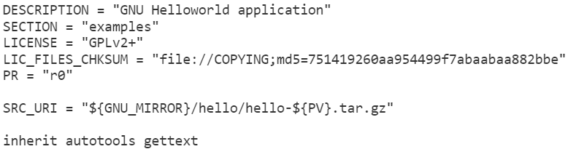
Write recipe for new package
Create new .bb file with content as following incase your package is autotools style

Slide 37
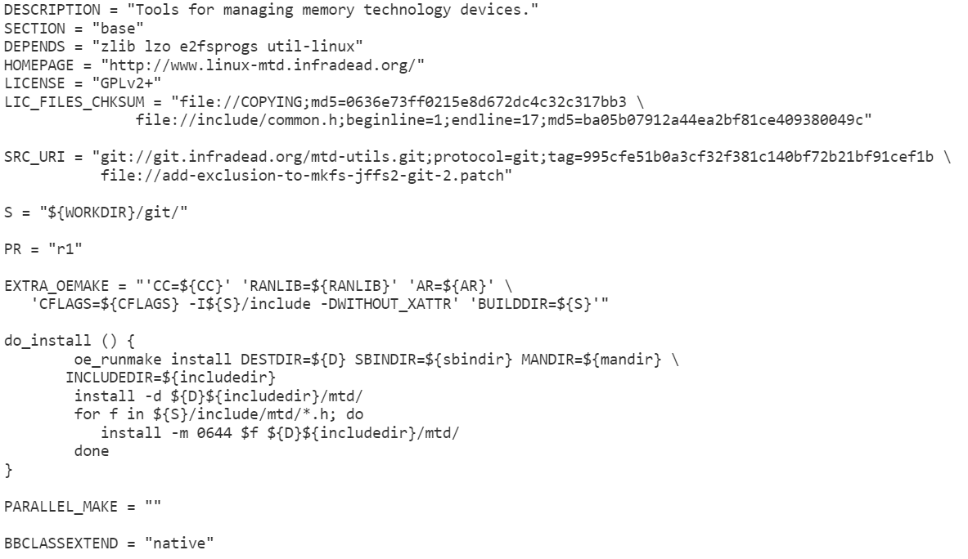
Write recipe for new package
Makefile-based package

Slide 38
Appending to an Existing Recipe
Creating a <pkg>.bbappend file with an identical package basename
bitbake-layers show-appends | grep alsa-lib
sources/meta-freescale/recipes-multimedia/alsa/alsa-lib_%.bbappend
FILESEXTRAPATHS_prepend := "${THISDIR}/${PN}:"
IMX_PATCH = " \
file://0001-add-conf-for-multichannel-support-in-imx.patch \
file://0004-pcm-Don-t-store-the-state-for-SND_PCM_STATE_SUSPENDE.patch \
file://0005-add-ak4458-conf-for-multichannel-support.patch \
"
SRC_URI_append_imx = "${IMX_PATCH}"
PACKAGE_ARCH_imx = "${MACHINE_SOCARCH}"

Slide 39
Add package to yocto image
Create custom .bb file: copy the image screen_git.bb file to new file then update IMAGE_INSTALL variable (IMAGE_INSTALL += screen)
Edit in local.conf: Using IMAGE_INSTALL with _append operator
IMAGE_INSTALL_append = “ screen”
Core-minial.bb
Full-image.bb

Slide 40
LAYERs

Slide 41
Layers Intro
Yocto meta-data is organized into layers, so that configurations can be kept isolated from each other
The conf/bblayers.conf file defines the layers BitBake will parse, when determining which tasks to run
Package recipes are organized in layer sub-folders
In a BitBake command a packages may be fully qualified or specified by basename only :
<pkg basename>[_<version>][.bb]
Layers can have dependencies on other layers
See also : layers.openembedded.org/layerindex/branch/master/layers/

Slide 42
Layers
<build_env> └─ conf
└── bblayers.conf meta-*
├── conf
│ └── layer.conf
├── images
│ ├── <image name>.bb │ ... │
├── recipes-<category>
... ├── <recipe folder>
... ├── files │ └── <explicit files>
└── <recipe>.bb
build env's active layers
a layer folder
this layer's config file
an image recipe
a recipe category folder
a recipe folder
locally stored files
a package recipe

Slide 43
Creating a New Layer
When modifying existing packages and images or developing new ones ➔ !!! Create and work in your own custom layer !!!
avoids having to modify any of the SDK provided layers
isolates your changes for released layers
The following customization examples are fully contained within a new meta-custom layer
This custom layer, its recipes and source files are available with this slide deck

Slide 44
Creating a New Layer
Make a new layer directory : <layer location>/meta-custom
Create a new meta-custom/conf/layer.conf file from a copy of meta-freescale/conf/layer.conf and change as shown :
[meta-custom/conf/layer.conf]
# We have a packages directory, add to BBFILES
BBPATH := "${BBPATH}:${LAYERDIR}"
BBFILES += "${LAYERDIR}/recipes-*/*/*.bb*"
BBFILES += "${LAYERDIR}/images/*.bb*"
BBFILE_COLLECTIONS += "custom"
BBFILE_PATTERN_custom := "^${LAYERDIR}/"
BBFILE_PRIORITY_custom = "6"
Metadata from higher priority layers overrides same from lower priority layers. Execute "bitbake-layers show-layers" to see layer priorities

Slide 45
Creating a New Layer
Enable custom layer in directory : <builddir location>/conf/bblayer.conf
# LAYER_CONF_VERSION is increased each time build/conf/bblayers.conf
# changes incompatibly
LCONF_VERSION = "6"
BBPATH = "${TOPDIR}"
BBFILES ?= ""
BBLAYERS ?= " \
/opt/yt_sdks/yocto/poky/meta \
/opt/yt_sdks/yocto/poky/meta-yocto \
/opt/yt_sdks/yocto/poky/meta-yocto-bsp \
/opt/yt_sdks/yocto/meta-fsl-ppc \
/opt/yt_sdks/yocto/meta-fsl-toolchain \
/opt/yt_sdks/yocto/meta-fsl-networking \
/opt/yt_sdks/yocto/meta-virtualization \ ...
/opt/yt_sdks/yocto/meta-cloud-services/meta-openstack \
/opt/yt_sdks/yocto/meta-cloud-services/meta-openstack-compute-deploy \
/opt/yt_sdks/yocto/meta-cloud-services/meta-openstack-controller-deploy \ ...
/opt/yt_sdks/yocto/meta-custom \
"
BBLAYERS_NON_REMOVABLE ?= " \
/opt/yt_sdks/yocto/poky/meta \
/opt/yt_sdks/yocto/meta-yocto \
"
Add the custom layer to <build_env>/conf/bblayers.conf

Slide 46
show-layers
Shows the active layers for the build environment
$ bitbake-layers show-layers layer path priority
==========================================================================
meta /yocto_build/git_repos/yocto_benchmark/Yocto/poky/meta 5
meta-yocto /yocto_build/git_repos/yocto_benchmark/Yocto/poky/meta-yocto 5
meta-yocto-bsp /yocto_build/git_repos/yocto_benchmark/Yocto/poky/meta-yocto-bsp 5
meta-fsl-arm /yocto_build/git_repos/yocto_benchmark/Yocto/meta-fsl-arm 5
meta-fsl-networking /yocto_build/git_repos/yocto_benchmark/Yocto/meta-fsl-networking 5
meta-fsl-toolchain /yocto_build/git_repos/yocto_benchmark/Yocto/meta-fsl-toolchain 5
meta-virtualization /yocto_build/git_repos/yocto_benchmark/Yocto/meta-virtualization 8
meta-fsl-s32v /yocto_build/git_repos/yocto_benchmark/Yocto/meta-fsl-s32v 7
meta-oe /yocto_build/git_repos/yocto_benchmark/Yocto/meta-oe/meta-oe 1
meta-networking /yocto_build/git_repos/yocto_benchmark/Yocto/meta-oe/meta-networking 5
meta-python /yocto_build/git_repos/yocto_benchmark/Yocto/meta-oe/meta-python 7
meta-webserver /yocto_build/git_repos/yocto_benchmark/Yocto/meta-oe/meta-webserver 6
meta-filesystems /yocto_build/git_repos/yocto_benchmark/Yocto/meta-oe/meta-filesystems 6
meta-linaro /yocto_build/git_repos/yocto_benchmark/Yocto/meta-linaro/meta-linaro 25
meta-aarch64 /yocto_build/git_repos/yocto_benchmark/Yocto/meta-linaro/meta-aarch64 20
meta-linaro-toolchain /yocto_build/git_repos/yocto_benchmark/Yocto/meta-linaro/meta-linaro-toolchain 30

Slide 47
Tip & TrICK

Slide 48
BitBake devshell Command : bitbake -c devshell
To work interactively with a package :
A new console window will open :
with PATH variable set to include the cross toolchain
pkgconfig variables find the correct .pc files.
configure finds all the necessary files
working directory is changed to the ${S} directory
Within this devshell you can manually execute commands, like ./configure or make and invoke the cross compiler directly
Use when adapting an external package to the Yocto build system
$ bitbake -c devshell <pkg>

Slide 49
BitBake devshell Manual Compilation for Quick Turnaround
Building the kernel, u-boot or any other package in a BitBake devshell avoids the overhead of the BitBake build framework and allows faster edit/build/test cycles.
Procedure :
Install the source tree for the package
Optionally configure the source tree using bitbake -c configure
Launch a devshell for the package
In a devshell it is easy to build a source tree copy that exists outside of the Yocto build environment

Slide 50
BitBake devshell Example : Manually Compiling the Linux Kernel
$ bitbake -c configure virtual/kernel
$ bitbake -c devshell virtual/kernel
# pwd ← devshell has a '#' prompt .../tmp/work/imx6qsabresd-poky-linux-gnueabi/linux-imx/3.10.17-r0/git
# unset LDFLAGS ← required
# make -j 32 all ... LD [M] sound/usb/snd-usb-audio.ko
LD [M] sound/usb/snd-usbmidi-lib.ko
AS arch/arm/boot/compressed/piggy.lzo.o
LD arch/arm/boot/compressed/vmlinux
OBJCOPY arch/arm/boot/zImage
Kernel: arch/arm/boot/zImage is ready

Slide 51
BitBake devshell Example : Manually Compiling u-boot
$ bitbake -c configure u-boot
$ bitbake -c devshell u-boot
# unset LDFLAGS ← devshell console has a '#' prompt
# export CROSS_COMPILE=arm-poky-linux-gnueabi
# make mx6qsabresd_config ← optional manual configuration Configuring for mx6qsabresd - Board: mx6qsabresd, Options: IMX_CONFIG=board/freescale/imx/ddr/mx6q_4x_mt41j128.cfg,MX6Q, DEFAULT_FDT_FILE="imx6q-sabresd.dtb",DDR_MB=1024,SYS_USE_SPINOR
# make

Slide 52
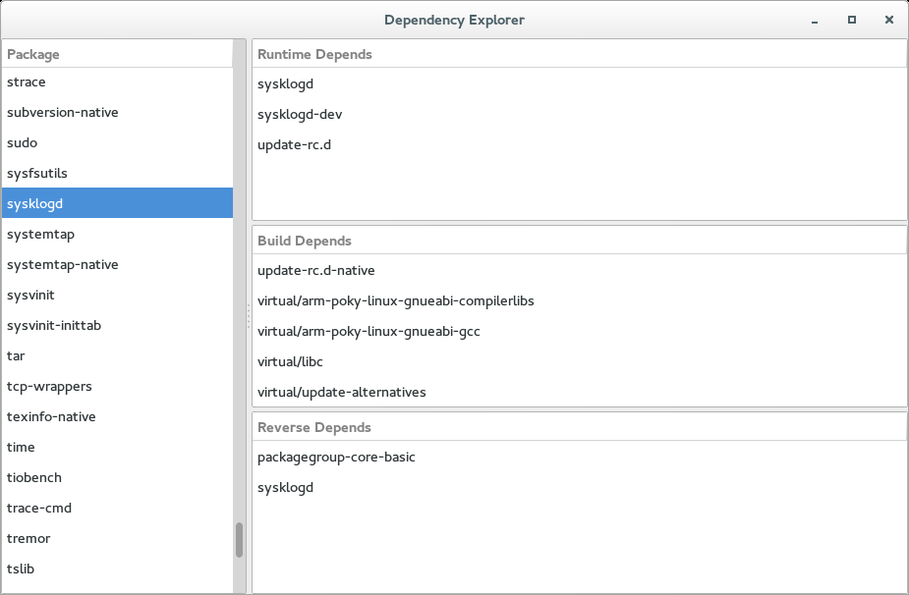
BitBake Dependency Explorer bitbake -g <image> -u depexp

Slide 53
Useful BitBake Options
Enable build output : -v
Generate bitbake debug output : -D, -DD, -DDD
Force rerun of specified task : -f, --force
Dump the environment : -e, --environment
Dump package dependency list : -g, --graphviz
Continue even in case of error : -k, --continue

Slide 54
Q & A

Slide 55
Thank You!

